Slide 1
Detection Of Depression From Textual Data In Social Media Using Machine Learning
Presented By :
Malavika P, Ashfaq K S, and Biju Skaria
Mar Athanasius College Of Engineering, Kothamangalam

Slide 2
INTRODUCTION
Background:
Depression is one of the leading causes of suicide worldwide. However, a large percentage of cases of depression go undiagnosed and, thus, untreated. Previous studies have found that messages posted by individuals with major depressive disorder on social media platforms can be analyzed to predict if they are suffering, or likely to suffer, from depression.
Purpose of the Project:
This study aims to detect depression from textual data posted on social media using machine learning classifiers and advanced feature extraction methods.
By analysing posts without relying on explicit keywords, the project seeks to identify patterns and signals indicative of depression, providing a tool for early detection and intervention.

Slide 3
OBJECTIVE AND SCOPE
Detect depression in social media text using machine learning and feature extraction techniques.
Use N-gram and TF-IDF (Term Frequency-Inverse Document Frequency) vectorization.
Detect depressive content without relying on specific keywords (e.g., “depressed”).
Implement Multi-Layer Perceptron (MLP), Random Forest (RF), and Decision Trees (DT).
Evaluate each algorithm to identify the best-performing model.
Build a web-based interface using Flask.
Allows users to input text and receive feedback on depressive content, with supportive suggestions if applicable.
Create an accurate, practical tool for detecting depression in social media text, offering supportive suggestions for user well-being.

Slide 4
METHODOLOGY
Data Collection and Preprocessing:
Use Depression Analysis Dataset by BB Eye from Kaggle.
which has 10314 records and is structured into three columns: the text of the post or comment, a unique identifier (id), and a class label.
Checked for missing values, duplicate values and dropped irrelevant features.
No missing values, duplicate values.

Slide 5
Text Preprocessing:
Removing Extra Spaces, Mentions, and Hyperlinks: Regular expressions eliminate unnecessary spaces, mentions (e.g., '@user'), and hyperlinks.
Removing Punctuation, Numbers, and Capitalization: Punctuation and numbers are removed, and text is converted to lowercase to ensure consistency.
Tokenization: The cleaned messages are split into individual words.
Stemming: Words are reduced to their root forms using the Porter stemming algorithm.
Stopword Removal: Common stopwords and Twitter-specific terms are filtered out.
Dataset Update: The processed messages are added as a new column in the dataset for further analysis.
NLTK handles stopwords and stemming, while the ‘re’ library manages string manipulation

Slide 6
Feature Extraction:
TF-IDF (Term Frequency-Inverse Document Frequency) vectorization technique is employed to convert a collection of text documents into a numerical representation that is suitable for machine learning tasks.
This code utilizes the TfidfVectorizer class from scikit-learn to perform TF-IDF feature extraction on a dataset of processed messages.
Configuration parameters used:
ngram_range = (1, 2): To capture both single words and two-word combinations.
max_df = 0.75: To filter out words appearing in more than 75% of the documents. min_df = 5: To exclude terms that appear in fewer than 5 documents.
max_features = 10,000: To limit the vocabulary size. The resultant TF-IDF matrix was converted into a Pandas DataFrame for easy inspection and analysis.

Slide 7
Model Selection and Evaluation:
Build and evaluate MLP, Decision Tree , and Random Forest models using metrics like accuracy, precision, recall, and F1 score.
Deployment:
Best model selected and deployed through a web interface.

Slide 8
RESULTS AND DISCUSSIONS
Algorithm | Accuracy | Precision | Recall | F1-score
Random Forest Classifier | 91 | 91 | 91 | 91
Decision Tree | 87 | 87 | 87 | 87
Multilayer Perceptron | 88 | 87 | 88 | 87
Random Forest provided the highest accuracy, indicating strong predictive capabilities when compared to DT and MLP.

Slide 9
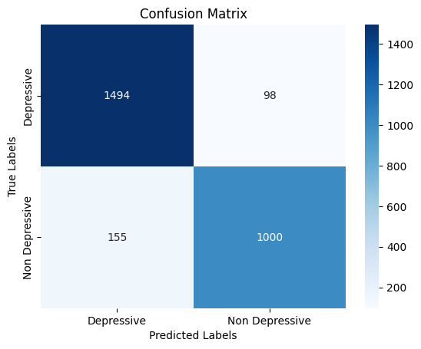
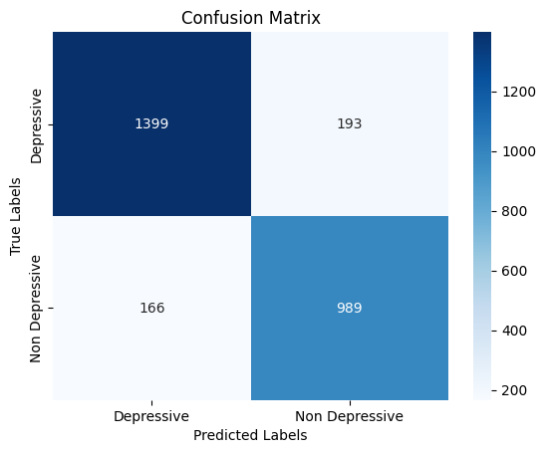
RF
DT

Slide 10

MLP
From the confusion matrices, we can also say that Random Forest gives us the best prediction, and Decision Tree gives us the poorest prediction in this case. As a result, we can conclude that for our chosen dataset, Random Forest is the best classification algorithm. Overall, RF is better as RF has fewer wrong predictions compared to DT and MLP and RF gives more correct predictions.

Slide 11
Future Scope
Incorporate Additional Data Sources:
Integrate behavioral data (e.g., user activity patterns, post frequency) to enhance diagnostic insights and detect complex depression cases.
Advanced Algorithms and Model Optimization:
Explore deep learning and RNNs to improve pattern detection.
Regularly retrain and optimize to adapt to language trends and user behavior.
Real-Time Social Media Integration:
Enable real-time analysis of user posts for immediate assessment and support, aiding early intervention.
Scalability and Cloud Deployment:
Deploy on the cloud for high scalability, handling large data volumes, and expanding access across platforms.
Enhanced UI and Mobile Access:
Develop a mobile-friendly interface with real-time feedback, intuitive navigation, and data visualization for better user engagement and mental health monitoring.

Slide 12
REFERENCES
Tadesse MM, Lin H, Xu B, Yang L. 2019. Detection of depression-related posts in reddit social media forum. Ieee Access. 7:44883-93.
Chiong R, Budhi GS, Dhakal S, Chiong F. 2021. A textual-based featuring approach for depression detection using machine learning classifiers and social media texts. Computers in Biology and Medicine. 135:104499.
Islam MR, Kabir MA, Ahmed A, Kamal AR, Wang H, Ulhaq A. 2018. Depression detection from social network data using machine learning techniques. Health information science and systems. 6:1-2.
Eye BB 2020 Depression Analysis. 1 edn., Kaggle Depression Analysis.

Slide 13
THANK YOU

